Slide 1

18ECE340T- MACHINE PERCEPTION WITH COGNITION
UNIT-1
S-9 Texture Synthesis
Prepared by
Dr. S. Vasanthadev SuryaKala,
Assistant Professor/ ECE

Slide 2
Introduction
Texture synthesis is an alternative way to create textures.
Because synthetic textures can be made of any size, visual repetition is avoided.
Texture synthesis can also produce tileable images by properly handling the boundary conditions.
Potential applications of texture synthesis are also broad; some examples are image de-noising, occlusion fill-in, and compression.

Slide 3
Introduction
The problem of texture synthesis can be stated as follows: Given a texture sample, synthesize a new texture that, when perceived by a human observer, appears to be generated by the same underlying stochastic process.
Our goal is to develop a new texture synthesis algorithm that is efficient, general, user-friendly, and able to produce high quality textures.
In addition, we would like to extend the horizon of texture synthesis by exploring a variety of new applications based on our algorithm.

Slide 4
Texture analysis
Texture plays an important role in many machine vision tasks such as surface inspection, scene classification, and surface orientation and shape determination.
Surface texture features are used in the inspection of semiconductor wafers, gray-level distribution features of homogeneous textured regions are used in the classification of aerial imagery.
Variations in texture patterns due to perspective projection are used to determine three dimensional shapes of objects.

Slide 5
Texture analysis
Texture is characterized by the spatial distribution of gray levels in a
neighborhood. Thus, texture cannot be defined for a point.
The resolution at which an image is observed determines the scale at which the texture is perceived.
Texture is defined as repeating patterns of local variations in image intensity which are too fine to be distinguished as separate objects at the observed resolution.
Thus, a connected set of pixels satisfying a given gray-level property which occur repeatedly in an image region constitutes a textured region.

Slide 6
Texture analysis
Texture is characterized by the spatial distribution of gray levels in a
neighborhood. Thus, texture cannot be defined for a point.
The resolution at which an image is observed determines the scale at which the texture is perceived.
Texture is defined as repeating patterns of local variations in image intensity which are too fine to be distinguished as separate objects at the observed resolution.
Thus, a connected set of pixels satisfying a given gray-level property which occur repeatedly in an image region constitutes a textured region.

Slide 7
Texture analysis
Each gray – level primitive is formed by the connected set of pixels representing each character.
The process of placing the characters on lines and placing lines in turn as elements of the page results in an ordered texture.
There are three primary issues in texture analysis: texture classification, texture segmentation, and shape recovery from texture.

Slide 8
Texture classification
In texture classification, the problem is identifying the given textured region from a given set of texture classes.
The class label of a single homogenous region is determined using properties computed from the region
Each of these regions has unique texture characteristics.
The texture analysis algorithms extract distinguishing features from each region to facilitate classification of such patterns.
Statistical methods are extensively used in texture classification.
Properties such as gray-level co-occurrence, contrast, entropy, and homogeneity are computed from image gray levels to facilitate classification.

Slide 9
Texture classification
The statistical methods are particularly useful when the texture primitives are small, resulting in microtextures.
On the other hand, when the size of the texture primitive is large, it becomes necessary to first determine the shape and properties of the basic primitive and then determine the rules which govern the placement of these primitives, forming macrotextures.
In model based methods to synthesize texture, a model for texture is first assumed and its parameters are then estimated from the image region such that an image synthesized using the model closely resembles the input image region.
The parameters are then useful as discriminating features to classify the region.

Slide 10
Texture segmentation
Texture segmentation is concerned with automatically determining the boundaries between various textured regions in an image.
Most of the statistical methods for determining the texture features do not provide accurate measures unless the computations are limited to a single texture region.
Both region-based methods and boundary-based methods have
been attempted to segment textured images.
Image plane variations in the texture properties, such as density, size, and orientation of texture primitives, are the cues exploited by shape-from texture algorithms.

Slide 11
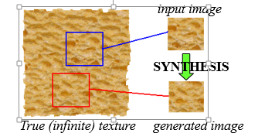
Texture synthesis
Given an input sample, texture synthesize a texture that is sufficiently different from the given sample texture, yet appears perceptually to be generated by the same underlying stochastic process.

Slide 12
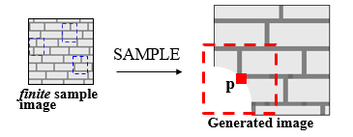
Texture synthesis
To synthesize a pixel p, search the sample image for pixels with similar neighborhood to p, construct a histogram for the distribution of these pixels, finally sample this distribution to obtain a value for p.
Similarity is based on the Gaussian- weighted sum squared difference, to preserve local structure.

Slide 13
Why only synthesize on pixel at the time?
For most complex textures only a very few pixels actually have a choice of values wasted search effort
Example: Pattern of circles on the plane
Once the algorithm starts synthesizing a particular circle, the values of the remaining pixels are completely determined.
Unit of synthesis should be more than just a pixel patch
Texture synthesis would be like jigsaw puzzle

Slide 14

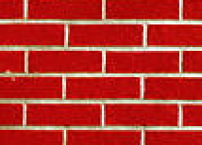
Image Quilting
non-parametric
sampling
p
B
Input image
Synthesizing a block
Idea: let’s combine random block placement of Chaos Mosaic with spatial constraints of Efros & Leung
Unit of synthesis is a block
Exactly the same but now we want P(B|N(B))
Much faster: synthesize all pixels in a block at once

Slide 15

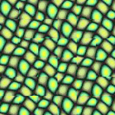
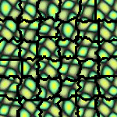
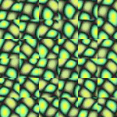
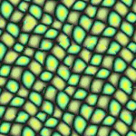
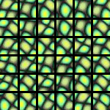
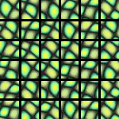
block
Input texture
B1
B2
B1
B2
B1
B2
Random placement
of blocks
Neighboring blocks
constrained by overlap
Minimal error
boundary cut

Slide 16
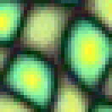
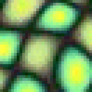
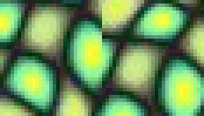

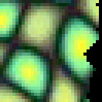
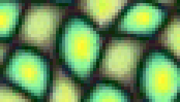

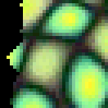
Minimal error boundary
overlapping blocks
vertical boundary
2
_
=
overlap error
min. error boundary

Slide 17
Image Quilting algorithm
Pick size of block and size of overlap
Synthesize blocks in raster order
Search input texture for block that satisfies overlap constraints (above and left)
Easy to optimize using NN search [Liang et.al., ’01]
Paste new block into resulting texture
use dynamic programming to compute minimal error boundary cut

Slide 18
Applications of texture synthesis
Occlusion fill-in
for 3D reconstruction
region-based image and video compression
a small sample of textured region is stored
Texturing non-developable objects
growing texture directly on surface
Motion synthesis
Synthesizing and transferring music and environmental sounds?
Rendering object in a different style without explicit 3D information

Slide 19
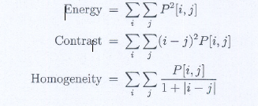
Texture synthesis for homogenity
The features of energy, contrast, and homogeneity are also defined using the gray-level co-occurrence matrix
Let P[I, j] be the gray-level co-occurrence matrix having gray levels I and j.

Slide 20
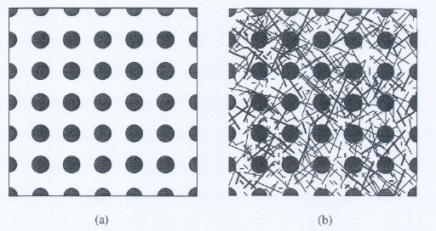
Shape from Texture
Variations in the size, shape, and density of texture primitives provide clues for estimation of surface shape and orientation.
These are exploited in shape from-texture methods to recover 3-D information from 2-D images.
Consider the regular ordered texture shown in Figure

Slide 21
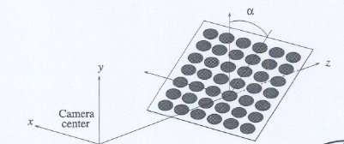
Shape from Texture
Figure is slanted at an angle a such that the top of the surface is farther away from the camera than the bottom.
Let us assume that all points along a given horizontal line are at the same depth from camera (i.e., there is no tilt) as shown in figure below.

Slide 22
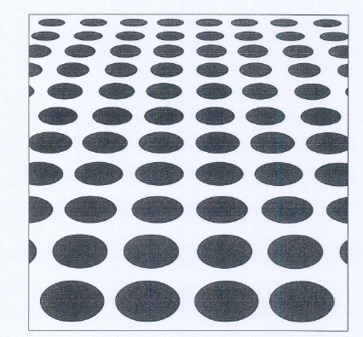
Shape from Texture
The image captured from the camera system is shown below.
Here the discs now appear as ellipses, which is a clue that the surface is not parallel to the image plane.
The sizes of these ellipses decrease as a function of y' in the image plane.

Slide 23
Shape from Texture
In other words, there are more ellipses for a unit area in the image plane near the top of the image compared with the center, resulting in a density gradient.
Furthermore, the aspect ratio (ratio of minor to major diameters of an ellipse) does not remain constant, resulting in an aspect ratio gradient.
To show this, we first derive an expression for the major and minor diameters of the ellipse as a function of the slant angle and the position of the ellipse in the image plane.
Let the diameter of the disc be d. Consider the disc at the image center.

Slide 24


Shape from Texture
The major diameter of the ellipse in the image plane corresponding to this disc is given by the perspective projection equation
where z is the distance of the disc from the camera center and f is the focal length of the camera.
The minor diameter of this ellipse is affected not only by the perspective projection but also by the foreshortening effect due to the slant angle 𝛂.
This is given by the equation

Slide 25
Shape from Texture
Thus, the aspect ratio of the ellipse at the center of the image plane is equal to cos𝛂.
All ellipses along the same horizontal line in the image plane will have the same aspect ratio.
Now consider an ellipse with its center at (0, y') in the image plane.
The disc corresponding to this ellipse is at an angle with respect to the optical axis as shown in Figure (b) and (c), where tan 𝜃 = y'/f.
The major diameter of the ellipse will be now modified.
Since the disc is now located at a distance S away from the camera center, z must be replaced with S.

Slide 26
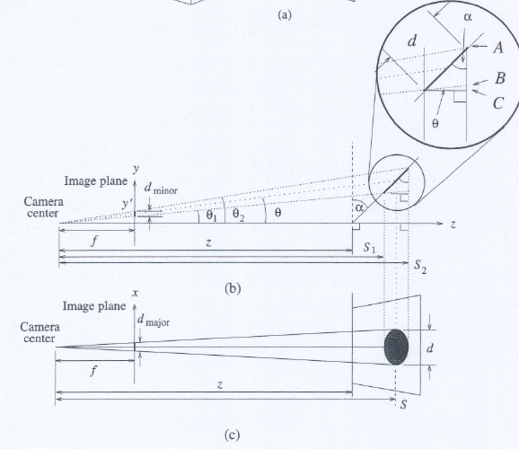
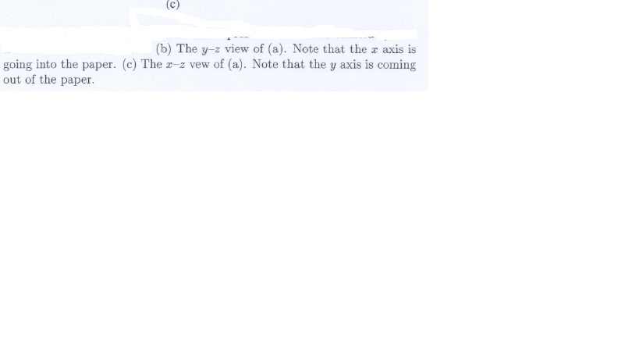
Shape from Texture

Slide 27



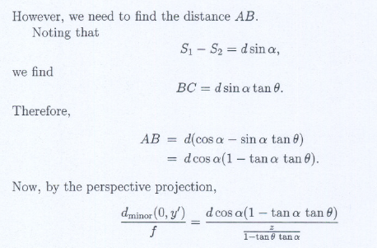
Shape from Texture
From figure (b) and (c)
Now if we assume that the diameter of the disk d is very small so that it subtends a small angle at the camera center, we can approximate
Therefore,

Slide 28
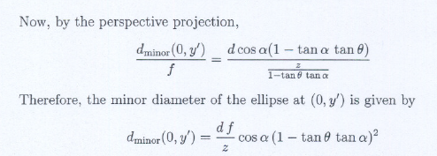
Shape from Texture
Thus, the aspect ratio given by cos𝛂( 1- tan𝜃 tan𝛂) decreases as 𝜃 increases, resulting in an aspect ratio gradient.
Variations in the image plane features such as size, shape, density, and aspect ratio of texture primitives can be exploited to recover the surface orientation (and ultimately the 3-D surface shape) of scene objects.

